Slide 1
Secure IoT Home Gateway & Home Registry - Idea
Jacques Latour, CTO Canadian Internet Registration Authority Dec 12, 2017

Slide 2

Today’s Home Network & IoT implementation are disparate, kind of scary & IN need OF structure!
Notes:
http://www.istockphoto.com/ca/photo/internet-of-things-concept-with-network-of-connected-objects-gm644680544-116869175

Slide 3
IoT Threat landscape SPECIFIC TO THE INTERNET - CURRENT
IoT device compromises:
Used in internet attacks i.e. MIRAI/DYN Attack (DDoS) targeting DNS servers (1.2 Tbs)
IoT traffic reflection and amplification
IoT device used to amplification traffic attack (DDoS) NTP, DNS, SNMP.
DNS compromises
Can be used to spoof DNS name, redirecting users to compromised web sites or services.
IoT devices must not have wide open internet access, inbound/outbound internet access must be controlled.

Slide 4

The home network of the future must be safe, secure and simple to use!
Notes:
http://www.istockphoto.com/ca/photo/circular-futuristic-interface-of-smart-home-automation-assistant-virtual-screen-gm637770524-113940363

Slide 5

The home network must be reachable from the internet seamlessly and securely
Notes:
http://www.istockphoto.com/ca/photo/businessman-touching-a-cloud-connected-to-objects-internet-of-things-gm514785054-88267551

Slide 6
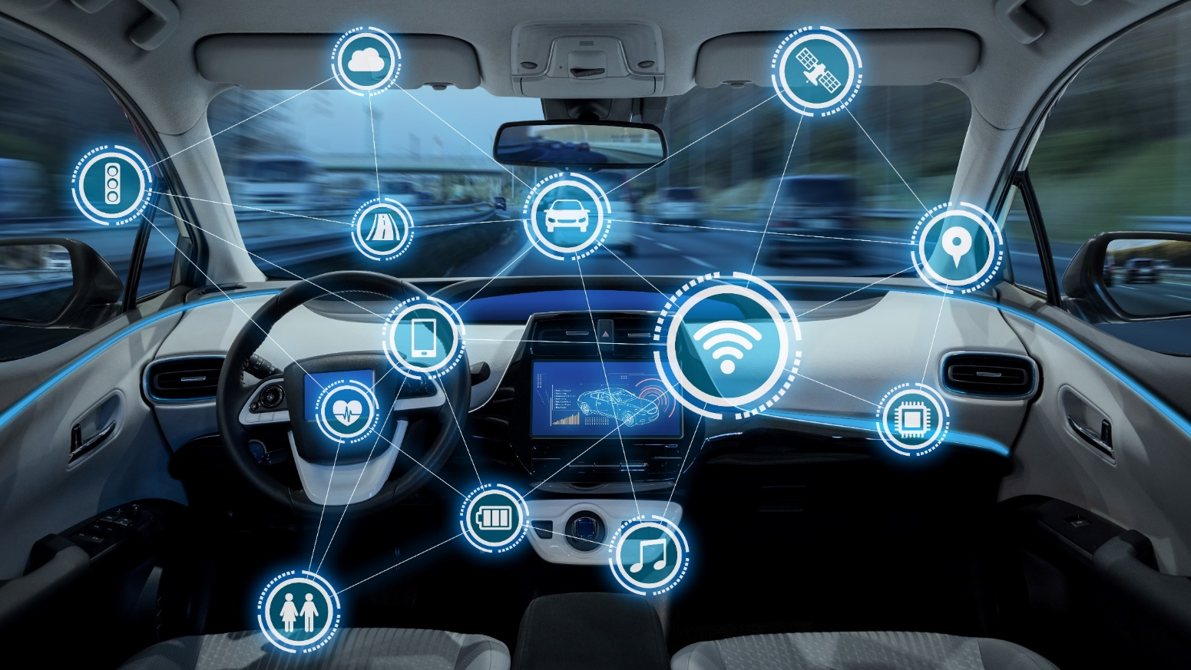
even your car WILL be connected to your home network
because your home is bigger than your house
Notes:
http://www.istockphoto.com/ca/photo/intelligent-vehicle-cockpit-and-wireless-communication-network-concept-gm692837788-127932641

Slide 7

The home network grows to include personal and wearable IoT, inside and outside the home…
because eventually they will be IPv6 enabled
Notes:
http://www.istockphoto.com/ca/photo/man-wearing-vr-headset-gm583697902-99848893

Slide 8


Your home network security both internal and external must be protected using a common key
Notes:
http://www.istockphoto.com/ca/photo/smart-phone-remote-for-smart-home-hologram-technology-concept-gm839028202-137738281

Slide 9

Do WE need to say more?
Public service announcement: We’re out of IPv4 addresses !!!
Notes:
http://www.istockphoto.com/ca/photo/ipv6-new-internet-protocol-gm502837022-82158325

Slide 10











Seriously, what does this bring to the domain industry?
myhome.ca
myhome.net.ca
IoT
Cloud
services
A domain name per household!!!
Notes:
http://www.istockphoto.com/ca/photo/home-computer-network-gm98265636-7381753
Need new picture, looks ugly ;-)

Slide 11

Leveraging the chain of trust in DNSSEC and some innovation to create a secure home network platform
Notes:
http://www.istockphoto.com/ca/photo/digital-handshake-on-blue-background-gm613033814-105721913

Slide 12
home.arpa. draft-ietf-homenet-dot-14
IETF working on making the default home network address: [yourprinter.]home.arpa.
<<The naming mechanism needs to function without configuration from the user. While it may be possible for a name to be delegated by an ISP, homenets must also function in the absence of such a delegation.>>
Let’s make delegated “home” domains function without user configuration!

Slide 13

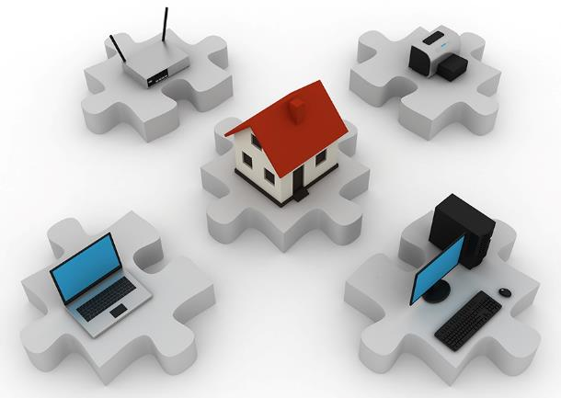
The focus is on AutomatioN
Registry
Automation
Home Network
Automation
+
Innovation
Notes:
http://www.istockphoto.com/ca/photo/home-network-gm117311543-7381629

Slide 14

Your local ccTLD will provision your DNSSEC signed domain internally on your gateway and externally as DNS primary, and establish a secure chain of trust to your home gateway, magically solving all your worries and keeping your online family safe ☺
Notes:
http://www.istockphoto.com/ca/photo/young-girl-looking-up-at-a-stereoscopic-vision-of-the-earth-internet-of-things-gm690778240-127332717

Slide 15
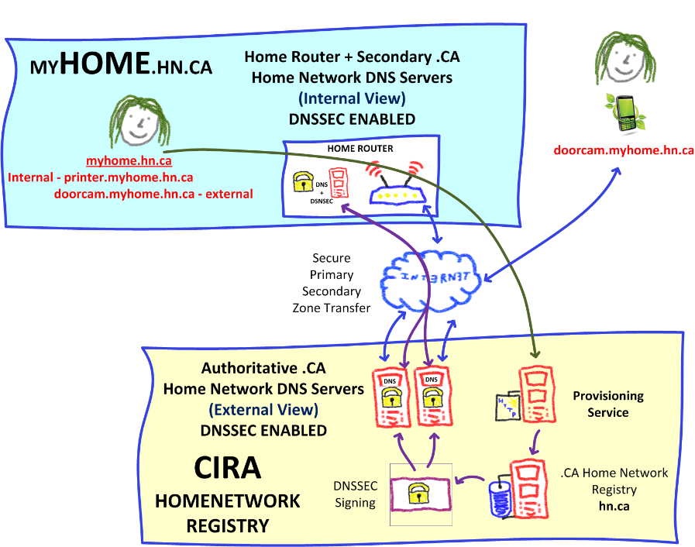
Remember, it’s an idea. So far it looks like this…
That’s
a napkin
design
☺

Slide 16

Step 1
When you buy a home gateway, it comes bundled with a .CA home network domain
+
A 2nd or 3rd level domain
i.e. myhome.net.ca
i.e. myhome.ca
RFID card
(Code to activate provisioning and domain)

Slide 17



Step 2
Then you follow the provisioning instructions
Install & open the CIRA Home Gateway app
Turn on the Home Gateway
“TAP” your mobile to discover the home gateway
Pick a domain name, 2nd or 3rd level domain name
Enter the secret code (“TAP” RFID card)
Home Gateway ready for configuration
+
myhome.ca code

Slide 18

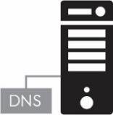
Step 3
Automated Backend Provisioning @ CIRA
CIRA creates the .CA domain name in the registry
CIRA signs the .CA domain with DNSSEC
CIRA is primary for the external DNS view of the .CA domain
CIRA provides secondary DNS to the .CA domain
+
+
.CA
Registry
EXTERNAL
(Internet)
DNSSEC
(Keys)

Slide 19

Step 4 (NEEDs WORK)
Automated Home Gateway provisioning
Establish secure connection to Home Gateway
Securely send private DNSSEC key to Home Gateway, setup internal DNS and DNSSEC
Configure Home Gateway for DNS integration with registry (à la dynamic DNS) for external services
+
+
←→
DNSSEC
(Keys)
EXTERNAL
(Internet)
INTERNAL
(Home Network)
Dynamic DNS

Slide 20


Step 5
Setup secure home network infrastructure
Using your trusted mobile & the app, “TAP” the Home Gateway to:
Learn the WIFI password
Get the IPSec password and keys to VPN in your home network
Use your mobile and “TAP” all your IoT devices to add on your home WIFI network, easy peasy ☺

Slide 21
Examples to:
Example of pushing WIFI to the device
show that the fridge is exposing service
And ready to receive services {WIFI}
No web interface on IoT device
Focus on cloud / vendor, show they integrate into this solution, can be multi vendor multi cloud provides

Slide 22






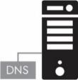



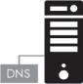
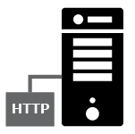

High Level SOLUTION Architecture
Internet Home Network Trust
OpenWrt
Home Gateway
Internal DNS/DNSSEC
External IPSEC
D-Zone firewall
Wifi MiFi Zigbee
NFC RFID
myhome.ca
Remote Home Network Access
(VPN IPSec)
IoT Cloud
Services
(D-Zone Firewall)
Home Network Registry
Primary DNS
.CA home domain
.CA home domain
Home Gateway
Provisioning
IPv6 ONLY
☺

Slide 23
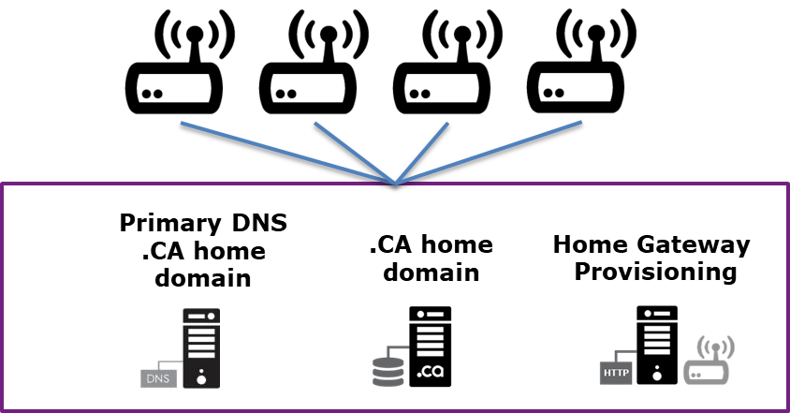

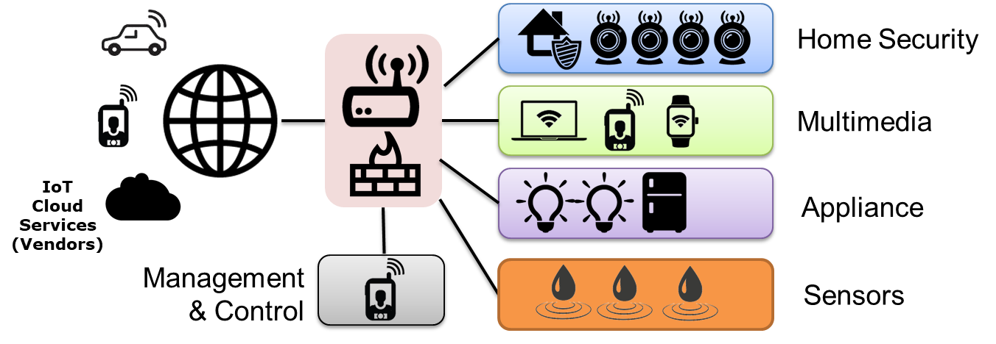
2 distinct ideas into one solution
IDEA #1 – ccTLD Home Registry
Value Proposition:
For ccTLD, to have a domain per household
Leverage the DNSSEC chain of trust by having a registered domain for home use
.CA Home Registry
IDEA #2 – Secure Gateway
Value Proposition:
To create a security framework to protect the Internet from IoT device attacks
To enhance the home network privacy & security with network access controls
IoT Secure Home Gateway

Slide 24
At this point we have
A home gateway fully provisioned with a .CA domain name, with both internal and external domain name resolution, signed with DNSSEC.
WIFI and other networks securely provisioned and setup
Now we’re ready to provision the IoT devices
fridge.la-house-a-latour.ca Internal IP
printer.la-house-a-latour.ca Internal IP
Internal domain fully operational
Secured internally by DNSSEC
External domain to allow exposing internal services and make them available externally
vpn.la-house-a-latour.ca External IP

Slide 25


What about IoT security? What about the home network?
Protect IoT device (inbound and outbound access)
Rule 1: Place behind firewall
Rule 2: Segment network by IoT type (NAC)
Rule 3: Control access to and from the IoT device
Home Security
Multimedia
Appliance
IoT Cloud
Services
Sensors
Management

Slide 26
Network Access control (NAC) & default security controls
Something like ; packetfence on openwrt
Example of default zone security controls / policies
Home Security -> may have access to cloud
Emergency services may have access
Multimedia -> no access to internet
VPN may have access this zone
Appliance -> no access to internet
VPN may have access this zone
Allow mydaughter.ca to access
my Home Security and my Fridge

Slide 27
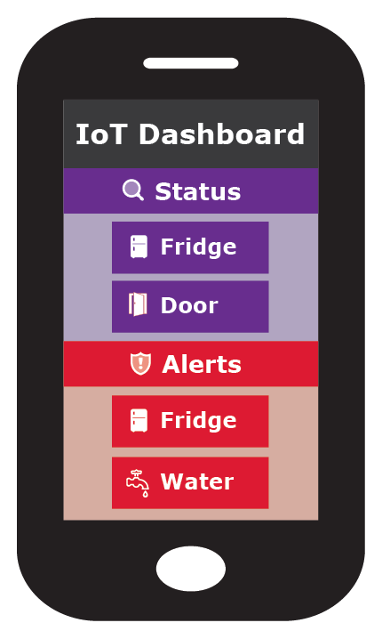
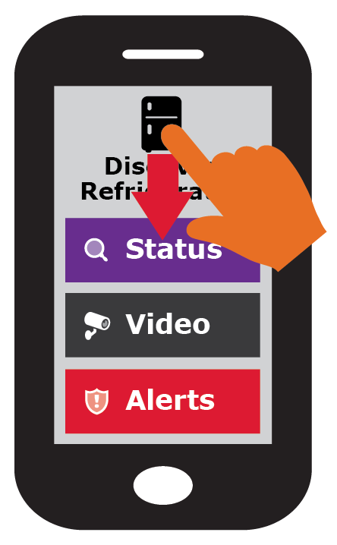
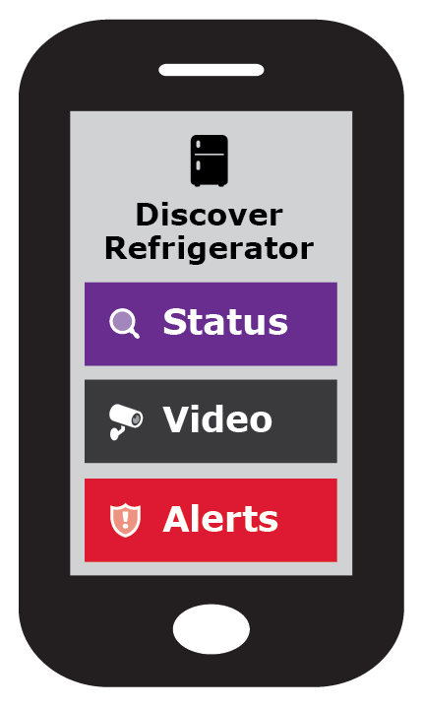






Now, let’s see how we provision IoT DEVICES IN HOME NETWORK
Once the IoT device has network access TAP to discover
IoT device exposes via RFID (or similar) the services available
Pick relevant IoT services category fro provisioning
Expose Services
JSON blob / RFID

Slide 28









IoT Service / action type
Status: Up/down, on/off, ok/bad, status variable
Audio/Video: Camera, video feed
Media: Audio/Video media feed, TV, music
Storage: Data storage, NAS (pictures, files, data)
Alerts: Up/down, on/off, ok/bad, “Water detected”
Control: Turn up/down, on/off, change device value
Cloud Service: IoT vendor, Google, MS, DropBox
VPN (VPN inside myhouse.ca)
Remote house access
Other Sensors/ Actuator functions?

Slide 29


Scenario: adding remote vpn access to trusted mobile
Mobile
(2) Grant permission and credentials to mobile for remote home access
(1) Tap the mobile
Discover services

Slide 30
Your home network security is compromised?
Get the ccTLD to perform an emergency DNSSEC key roll over, externally and on the home gateway
Will have new keys on home gateway
This will make all VPN keys & certificate invalid
A roll over will force the generation of new keys.
Trusted “management” home gateway mobile access must be re-established using an out of band token
Remote home access trust must be re-established
Local network access controls should remain the same

Slide 31



Scenario: Adding your Car
Car
(2) Assign roles
Control car feature
View car alerts
(1) Tap the car
Discover services
View car status/location
Grant permission and credentials to car mobile for remote home access

Slide 32

TODO: Scenario: Adding a smart TV
WORK IN PROGRESS

Slide 33
TODO: + ADD Scenarios FOR each device type
TODO: as part of the functional specification documentation.

Slide 34

What do you think?
Want to help?

Slide 35
Going forward, it’s a journey!
Motivation
Ensure long term ccTLD relevance in the future of IoT
To create a secure <internet home> IoT environment
Proposing ccTLD to develop a solution
To keep the home network safe and secure
To leverage DNSSEC as an innovation platform to create a hub for “home trust”
That leverages the ccTLD registry expertise
To enhance OpenWRT with this functionality

Slide 36
Next Steps
Develop a Proof of Concept and prototype
Using .CZ Omnia Home Gateway (openWRT)
Home Gateway App (Android/iPhone)
Develop some IoT discoverable devices (RFID)
Use public GitHub to document the functional specification and repo for prototype software
Functional specification
Software repository

Slide 37
The new <Internet Home>
https://github.com/CIRALabs/Home-Network-Registry-Gateway

